Slide 1

OM: MGMT 660
Queuing analysis by:
Kshitija Vijay Sulakhe, Rense George, Tejashree Shendge, Gaurang Singh

Slide 2
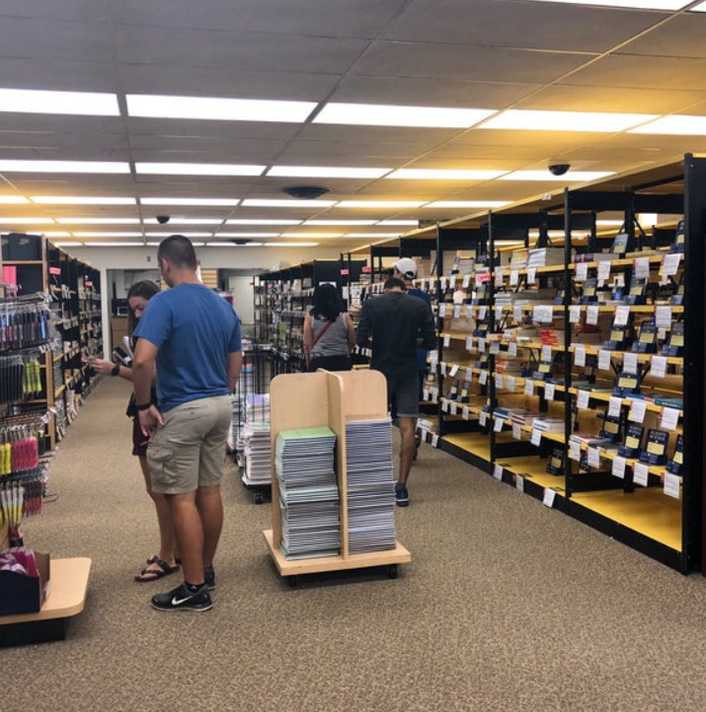
Introduction
● Data observations from the store
● Queuing Analysis for busiest week
● Queuing Analysis for regular week
● Project Experience
● Q&A

Slide 3
Data observations from the bookstore
Parameters | Busiest Week | Regular Week
Demand | 400 customers/hr | 50 customers/hr
Arrival time: a = 1/Demand | 0.15 mins/customer 9 secs/customer | 1.2 mins/customer 72 secs/customer
Service time (p) | 1 minute | 1 minute
Service rate/process capacity = 1/p | 60 customers/hr * m | 60 customers/hr * m
M: # of servers | 7,8,9,10 | 1,2,3,4
Flow rate | 400 | 50
CVa | 1 | 1
CVp | 1 | 1

Slide 4

Queuing Analysis for busiest week
# of servers | Utilization | Tq (min) | T(min)
7 | 95.23% | 2.55 | 3.55
8 | 83.33% | 0.41 | 1.41
9 | 74.07% | 0.15 | 1.15
10 | 66.67% | 0.06 | 1.06
Average no of people in the queue (Iq) = Waiting time (Tq) / arrival time (a)
= 17 (#7), 3 (#8) and so on.
Average no of people in the system (I) =
Total time in the system (T) / arrival time (a)
= 24 (#7), 10 (#8) and so on.

Slide 5

Queuing Analysis for regular week
# of servers | Utilization | Tq(min) | T(min)
1 | 83.33% | 4 | 5
2 | 41.66% | 0.25 | 1.25
3 | 27.78% | 0.044 | 1.04
4 | 20.83% | 0.01 | 1.01
Average no of people in the queue (Iq) = 1/a * Tq = 4.15 (#1), 0.28 (#2) and so on.
Average no of people in the system (I) = 1/a*T = 5 (#1), 1 (#2) and so on.

Slide 6

Project Outcomes
Stable queue analysis.
Relationship between waiting time and utilization.
Adding extra servers decreases the utilization and avg time of customers in system.
It is important to strike a perfect balance between cost and customer satisfaction.
Game day server utilization.

Slide 7

THANK YOU !

